Slide 1
CS 61C:
Great Ideas in Computer Architecture
Introduction to Hardware: Representations and State
Instructors:
Krste Asanović and Randy H. Katz
http://inst.eecs.Berkeley.edu/~cs61c/fa17

Slide 2
From Last Time: Where Are We Now?
C program: foo.c
Compiler
Executable (mach lang pgm): a.out
Memory
Assembly program: foo.s
Assembler
Object (mach lang module): foo.o
Linker
Loader
Translation: Compilation to Assembly
Replace pseudo with real instructions
Resolve local jumps, branches
Create Symbol, Relocation Tables
  Symbol Table: Labels defined or referenced
  Relocation Table: Address locations to be adjusted
lib.o
9/20/17
Fall 2017 - Lecture #9

Slide 3
Linker (2/3)
.o file 1
text 1
a.out
data 1
Relocated text 1
info 1
Relocated text 2
Linker
.o file 2
Relocated data 1
text 2
Relocated data 2
data 2
info 2
9/20/17
Fall 2017 - Lecture #9

Slide 4
Four Types of Addresses
PC-Relative Addressing (beq, bne, jal; lla: auipc/addi)
  Never need to relocate (PIC: position independent code)
Absolute Function Address (la: auipc/lw + jalr)
  Always relocate
External Function Reference (la: auipc/lw + jalr)
  Always relocate
Static Data References (lui/addi)
  Always relocate
9/20/17
Fall 2017 - Lecture #9

Slide 5
Resolving References (1/2)
Linker assumes first word of first text segment is at address 0x10000 for RV32.
  (More later when we study “virtual memory”)
Linker knows:
  Length of each text and data segment
  Ordering of text and data segments
Linker calculates:
  Absolute address of each label to be jumped to (internal or external) and each piece of data being referenced
9/20/17
Fall 2017 - Lecture #9

Slide 6
Resolving References (2/2)
To resolve references:
  Search for reference (data or label) in all “user” symbol tables
  If not found, search library files (e.g., for printf)
  Once absolute address is determined, fill in the machine code appropriately
Output of linker: executable file containing text and data (plus header)
9/20/17
Fall 2017 - Lecture #9

Slide 7
Where Are We Now?
C program: foo.c
Compiler
Executable (mach lang pgm): a.out
Memory
Assembly program: foo.s
Assembler
Object (mach lang module): foo.o
Linker
Loader
lib.o
9/20/17
Fall 2017 - Lecture #9

Slide 8
Loader Basics
Input: Executable Code (e.g., a.out for RISC-V)
Output: (program is run)
Executable files are stored on disk
When one is run, loader loads it into memory and start it
In reality, loader is the operating system (OS)
  Loading is one of the OS tasks
9/20/17
Fall 2017 - Lecture #9

Slide 9
Loader … What Does It Do?
Reads executable file’s header to determine size of text and data segments
Creates new address space for program large enough to hold text and data segments, along with a stack segment
Copies instructions + data from executable file into the new address space
Copies arguments passed to the program onto the stack
Initializes machine registers
  Most registers cleared, but stack pointer assigned address of 1st free stack location
Jumps to start-up routine that copies program’s arguments from stack to registers & sets the PC
  If main routine returns, start-up routine terminates program with the exit system call
9/20/17
Fall 2017 - Lecture #9

Slide 10
Peer Instruction
At what point in process are all the machine code bits determined for the following assembly instructions:
1) add x6, x7, x8
2) jal x1, fprintf
A: 1) & 2) After compilation
B: 1) After compilation, 2) After assembly
C: 1) After assembly, 2) After linking
D: 1) After assembly, 2) After loading
9/20/17
Fall 2017 - Lecture #9

Slide 11
Example C Program: Hello.c
#include <stdio.h>
int main()
{
printf("Hello, %s\n", "world");
return 0;
}
9/20/17
Fall 2017 - Lecture #9
11

Slide 12
Compiled Hello.c: Hello.s
.text
.align 2
.globl main
main:
addi sp,sp,-16
sw ra,12(sp)
lui a0,%hi(string1)
addi a0,a0,%lo(string1)
lui a1,%hi(string2)
addi a1,a1,%lo(string2)
call printf
lw ra,12(sp)
addi sp,sp,16
li a0,0
ret
.section .rodata
.balign 4
string1:
.string "Hello, %s!\n"
string2:
.string "world"
# Directive: enter text section
# Directive: align code to 2^2 bytes
# Directive: declare global symbol main
# label for start of main
# allocate stack frame
# save return address
# compute address of
# string1
# compute address of
# string2
# call function printf
# restore return address
# deallocate stack frame
# load return value 0
# return
# Directive: enter read-only data section
# Directive: align data section to 4 bytes
# label for first string
# Directive: null-terminated string
# label for second string
# Directive: null-terminated string
9/20/17
Fall 2017 - Lecture #9
12

Slide 13
Assembled Hello.s: Linkable Hello.o
00000000 <main>:
0: ff010113 addi sp,sp,-16
4: 00112623 sw ra,12(sp)
8: 00000537 lui a0,0x0 # addr placeholder
c: 00050513 addi a0,a0,0 # addr placeholder
10: 000005b7 lui a1,0x0 # addr placeholder
14: 00058593 addi a1,a1,0 # addr placeholder
18: 00000097 auipc ra,0x0 # addr placeholder
1c: 000080e7 jalr ra # addr placeholder
20: 00c12083 lw ra,12(sp)
24: 01010113 addi sp,sp,16
28: 00000513 addi a0,a0,0
2c: 00008067 jalr ra
9/20/17
Fall 2017 - Lecture #9
13

Slide 14
Linked Hello.o: a.out
000101b0 <main>:
101b0: ff010113 addi sp,sp,-16
101b4: 00112623 sw ra,12(sp)
101b8: 00021537 lui a0,0x21
101bc: a1050513 addi a0,a0,-1520 # 20a10 <string1>
101c0: 000215b7 lui a1,0x21
101c4: a1c58593 addi a1,a1,-1508 # 20a1c <string2>
101c8: 288000ef jal ra,0x10450 # 10450 <printf>
101cc: 00c12083 lw ra,12(sp)
101d0: 01010113 addi sp,sp,16
101d4: 00000513 addi a0,0,0
101d8: 00008067 jalr ra
9/20/17
Fall 2017 - Lecture #9
Notes:
1520= 0x5F0
-0x5F0 = 0xFFFFFA10
0x00020A10 – X + 0xFFFFFA10
X = 0x00020A10 – 0xFFFFFA10
X[32:12] = 0x00020 – 0xFFFFF = 0x00020 + 1 = 0x21
0x20a10 = 0x00020000 + 0x00000a10 = 0x00020000 + 0xfffffa10 – 0xfffff000 = 0x00020000 + 0xfffffa10 + 0x00001000 (twos complement of 0xfffff000)
Note: there is NO subi in RISC-V

Slide 15
LUI/ADDI Address Calculation in RISC-V
Target address of <string1> is 0x00020 A10
Instruction sequence LUI 0x00020, ADDI 0xA10 does not quite work because immediates in RISC-V are sign extended (and 0xA10 has a 1 in the high order bit)!
0x00020 000 + 0xFFFFF A10 = 0x0001F A10 (Off by 0x00001 000)
So we get the right address if we calculate it as follows:
(0x00020 000 + 0x00001 000) + 0xFFFFF A10 = 0x00020 A10
What is 0xFFFFF A10?
Twos complement of 0xFFFFF A10 = 0x00000 5EF + 1 = 0x00000 5F0 = 1520_{ten}
So 0xFFFFF A10 = -1520_{ten}
Instruction sequence LUI 0x00021, ADDI -1520 calculates 0x00020 A10
9/20/17
Fall 2017 - Lecture #9

Slide 16
Break!
9/20/17
Fall 2017 - Lecture #9

Slide 17





You are Here!
Software Hardware
Parallel Requests
  Assigned to computer
  e.g., Search “Katz”
Parallel Threads
  Assigned to core
  e.g., Lookup, Ads
Parallel Instructions
  >1 instruction @ one time
  e.g., 5 pipelined instructions
Parallel Data
  >1 data item @ one time
  e.g., Add of 4 pairs of words
Hardware descriptions
  All gates @ one time
Programming Languages
Warehouse Scale Computer
Smart
Phone
Harness
Parallelism &
Achieve High
Performance
Computer
Core
…
Core
Memory (Cache)
Input/Output
Core
Instruction Unit(s)
Functional
Unit(s)
A₀+B₀
A₁+B₁
A₂+B₂
A₃+B₃
Cache Memory
Today
Logic Gates

Slide 18

Levels of Representation/Interpretation
High Level Language
Program (e.g., C)
temp = v[k];
v[k] = v[k+1];
v[k+1] = temp;
Compiler
Anything can be represented
as a number,
i.e., data or instructions
lw $t0, 0($2)
lw $t1, 4($2)
sw $t1, 0($2)
sw $t0, 4($2)
Assembly Language Program (e.g., RISC-V)
Assembler
0000 1001 1100 0110 1010 1111 0101 1000
1010 1111 0101 1000 0000 1001 1100 0110
1100 0110 1010 1111 0101 1000 0000 1001
0101 1000 0000 1001 1100 0110 1010 1111
Machine Language Program (RISC-V)
Machine Interpretation
Hardware Architecture Description
(e.g., block diagrams)
Architecture Implementation
Logic Circuit Description
(Circuit Schematic Diagrams)

Slide 19
Agenda
Switching Networks, Transistors
Gates and Truth Tables for Circuits
Boolean Algebra
Logisim
And in Conclusion, …

Slide 20
Agenda
Switching Networks, Transistors
Gates and Truth Tables for Circuits
Boolean Algebra
Logisim
And in Conclusion, …

Slide 21
Hardware Design
Next several weeks: how a modern processor is built, starting with basic elements as building blocks
Why study hardware design?
  Understand capabilities and limitations of hw in general and processors in particular
  What processors can do fast and what they can’t do fast
  (avoid slow things if you want your code to run fast!)
  Background for more in depth hw courses (CS 152)
  Hard to know what will need for next 30 years
  There is just so much you can do with standard processors: you may need to design own custom hw for extra performance
    Even some commercial processors today have customizable hardware!

Slide 22
Synchronous Digital Systems
Hardware of a processor, such as the RISC-V, is an example of a Synchronous Digital System
Synchronous:
  All operations coordinated by a central clock
    “Heartbeat” of the system!
Digital:
  Represent all values by two discrete values
  Electrical signals are treated as 1’s and 0’s
    1 and 0 are complements of each other
  High /low voltage for true / false, 1 / 0

Slide 23
Switches: Basic Element of Physical Implementations
Implementing a simple circuit (arrow shows action if wire changes to “1” or is asserted):
A
Z
Close switch (if A is “1” or asserted)
and turn on light bulb (Z)
Z
A
Open switch (if A is “0” or
unasserted) and turn off light
bulb (Z)
Z ≡ A

Slide 24
Switches (cont’d)
Compose switches into more complex ones (Boolean functions):
A
B
AND
Z ≡ A and B
A
OR
Z ≡ A or B
B

Slide 25

Historical Note
Early computer designers built ad hoc circuits from switches
Began to notice common patterns in their work: ANDs, ORs, …
Master’s thesis (by Claude Shannon) made link between work and 19th Century Mathematician George Boole
  Called it “Boolean” in his honor
Could apply math to give theory to
hardware design, minimization, …

Slide 26
Transistors
High voltage (V_{dd}) represents 1, or true
Low voltage (0 volts or Ground) represents 0, or false
Let threshold voltage (V_{th}) decide if a 0 or a 1
If switches control whether voltages can propagate through a circuit, can build a computer
Our switches: CMOS transistors

Slide 27
CMOS Transistor Networks
Modern digital systems designed in CMOS
  MOS: Metal-Oxide on Semiconductor
  C for complementary: use pairs of normally-open and normally-closed switches
    Used to be called COS-MOS for complementary-symmetry -MOS
CMOS transistors act as voltage-controlled switches
  Similar, though easier to work with, than relay switches from earlier era
  Use energy primarily when switching
Notes:
Wikipedia: The phrase "metal–oxide–semiconductor" is a reference to the physical structure of certain field-effect transistors, having a metal gate electrode placed on top of an oxide insulator, which in turn is on top of a semiconductor material.
CMOS circuits use a combination of p-type and n-type metal–oxide–semiconductor field-effect transistors (MOSFETs)

Slide 28
CMOS Transistors
Gate
Source
Drain
Three terminals: source, gate, and drain
  Switch action:
  if voltage on gate terminal is (some amount) higher/lower than source terminal then conducting path established between drain and source terminals (switch is closed)
Note circle symbol to indicate “NOT” or “complement”
Gate
Gate
Source
Drain
Source
Drain
n-channel transitor
open when voltage at Gate is low
closes when:
voltage(Gate) > voltage (Threshold)
(High resistance when gate voltage Low,
Low resistance when gate voltage High)
p-channel transistor
closed when voltage at Gate is low
opens when:
voltage(Gate) > voltage (Threshold)
(Low resistance when gate voltage Low,
High resistance when gate voltage High)
Notes:
From wikipedia:
The field-effect transistor (FET) relies on an electric field to control the shape and hence the conductivity of a channel of one type of charge carrier in a semiconductor material.
The most commonly used FET is the MOSFET. The CMOS (complementary-symmetry metal oxide semiconductor) process technology is the basis for modern digital integrated circuits. This process technology uses an arrangement where the (usually "enhancement-mode") p-channel MOSFET and n-channel MOSFET are connected in series such that when one is on, the other is off.
CMOS circuits are constructed in such a way that all PMOS transistors must have either an input from the voltage source or from another PMOS transistor. Similarly, all NMOS transistors must have either an input from ground or from another NMOS transistor. The composition of a PMOS transistor creates low resistance between its source and drain contacts when a low gate voltage is applied and high resistance when a high gate voltage is applied.
On the other hand, the composition of an NMOS transistor creates high resistance between source and drain when a low gate voltage is applied and low resistance when a high gate voltage is applied.

Slide 29
CMOS Circuit Rules
Don’t pass weak values => Use Complementary Pairs
  N-type transistors pass weak 1’s (V_{dd} - V_{th})
  N-type transistors pass strong 0’s (ground)
  Use N-type transistors only to pass 0’s (N for negative)
  Converse for P-type transistors: Pass weak 0s, strong 1s
    Pass weak 0’s (V_{th}), strong 1’s (V_{dd})
    Use P-type transistors only to pass 1’s (P for positive)
  Use pairs of N-type and P-type to get strong values
Never leave a wire undriven
  Make sure there’s always a path to V_{dd} or gnd
Never create a path from V_{dd} to gnd (ground)
Notes:
Wikipedia: CMOS accomplishes current reduction by complementing every nMOSFET with a pMOSFET and connecting both gates and both drains together. A high voltage on the gates will cause the nMOSFET to conduct and the pMOSFET not to conduct while a low voltage on the gates causes the reverse. This arrangement greatly reduces power consumption and heat generation. However, during the switching time both MOSFETs conduct briefly as the gate voltage goes from one state to another. This induces a brief spike in power consumption and becomes a serious issue at high frequencies.

Slide 30
Agenda
Switching Networks, Transistors
Gates and Truth Tables for Circuits
Boolean Algebra
Logisim
And in Conclusion, …

Slide 31
MOS Networks
p-channel transistor
closed when voltage at Gate is low
opens when:
voltage(Gate) > voltage (Threshold)
X
what is the
relationship
between x and y?
1v
x
y
Y
0 volts
(gnd)
0v
1 volt
(Vdd)
n-channel transitor
open when voltage at Gate is low
closes when:
voltage(Gate) > voltage (Threshold)
Called an inverter or not gate
Notes:
X = 0 implies top switch is closed, so 3V sent Y
X = 0 implies bottom switch is open, so nothing sent to Y
X = 3v implies Top switch is open, so nothing sent to Y
X = 3v implies Bottom switch is closed, so 0V sent Y
Wikipedia:
The image shows what happens when an input is connected to both a PMOS transistor (top of diagram) and an NMOS transistor (bottom of diagram). When the voltage of input X is low, the NMOS transistor's channel is in a high resistance state. This limits the current that can flow from Y to ground.
The PMOS transistor's channel is in a low resistance state and much more current can flow from the supply to the output. Because the resistance between the supply voltage and Y is low, the voltage drop between the supply voltage and Y due to a current drawn from Y is small. The output therefore registers a high voltage.
On the other hand, when the voltage of input X is high, the PMOS transistor is in an OFF (high resistance) state so it would limit the current flowing from the positive supply to the output, while the NMOS transistor is in an ON (low resistance) state, allowing the output to drain to ground.
Because the resistance between Y and ground is low, the voltage drop due to a current drawn into Y placing Y above ground is small. This low drop results in the output registering a low voltage.
In short, the outputs of the PMOS and NMOS transistors are complementary such that when the input is low, the output is high, and when the input is high, the output is low. Because of this behavour of input and output, the CMOS circuits' output is the inverse of the input.

Slide 32
Two Input Networks
what is the
relationship between x, y and z?
X
Y
x
y
z
1v
0 volts
0 volts
0 volts
1 volt
Z
1 volt
0 volt
0v
1 volt
1 volt
X
Y
x
y
z
0 volts
0 volts
1v
0 volts
1 volt
Z
1 volt
0 volt
1 volt
1 volt
0v
Notes:
Top
X = 0v Y = 0V both closed on top, so Z = 3v
X = 0v Y = 0V both open bottom
X = 0v Y = 3V 2nd closed on top, so Z = 3v
X = 0v Y = 3V 2nd in series open
X = 3v Y = 0V 1st closed on top, so Z = 3v
X = 3v Y = 0V 1st in series open
X = 3v Y = 3V both open on top
X = 3v Y = 0V both closed, so Z = 0v

Slide 33
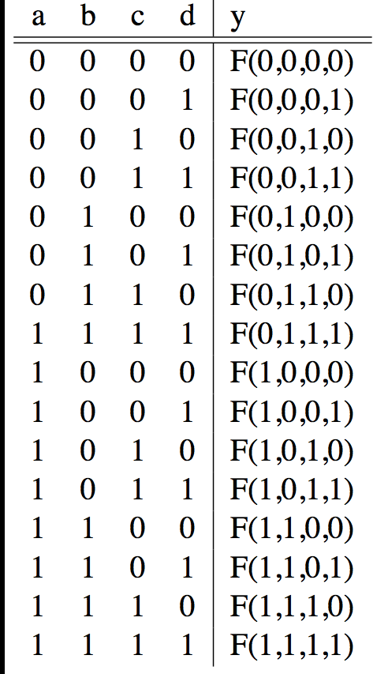
Truth Tables
List outputs for all possible inputs
A
F
B
Y
C
0
D

Slide 34
Truth Table Example #1: y= F(a,b): 1 iff a ≠ b
a | b | y
0 | 0 | 0
0 | 1 | 1
1 | 0 | 1
1 | 1 | 0
Y = A B + A B
Y = A + B
XOR

Slide 35
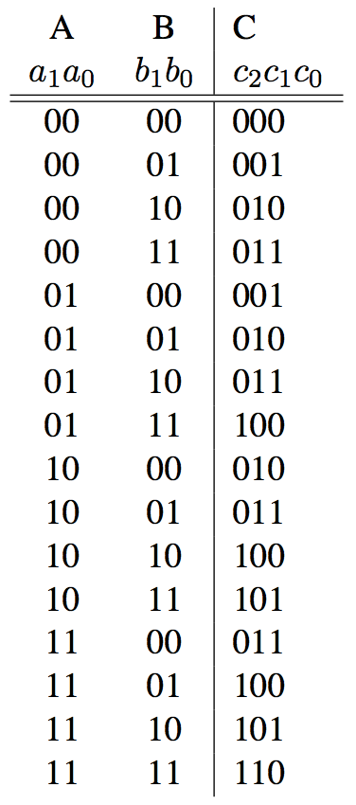
Truth Table Example #2:
2-bit Adder
How
Many
Rows?
A1
+
C2
A0
C1
B1
C0
B0

Slide 36
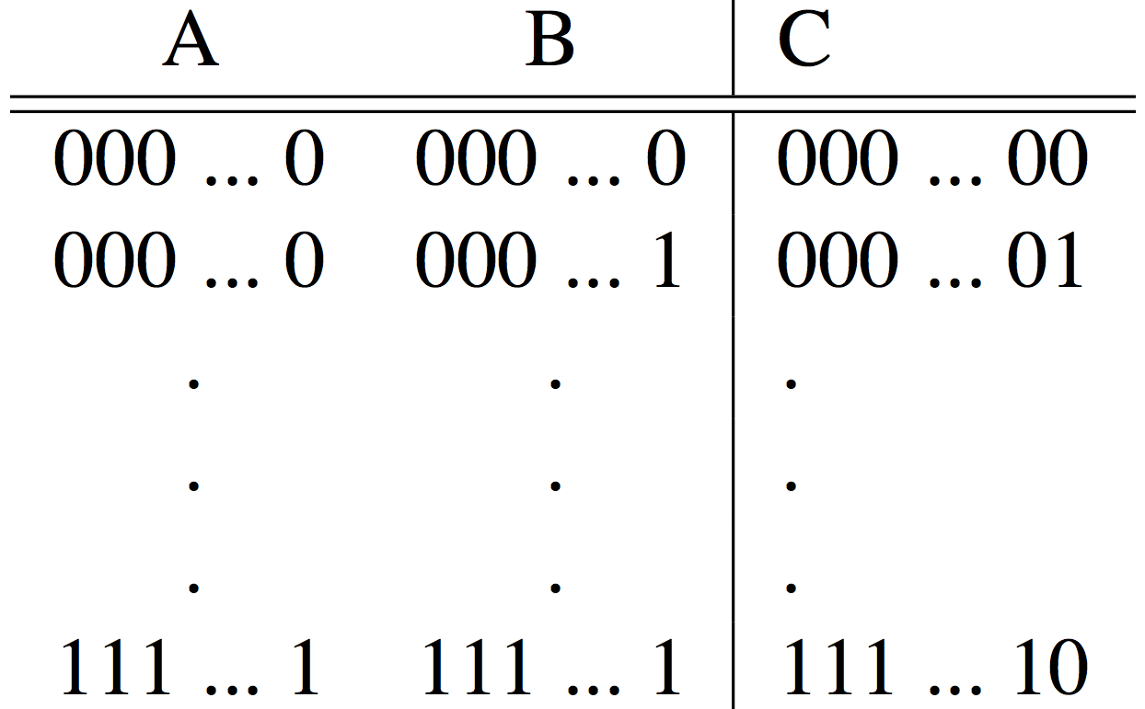
Truth Table Example #3:
32-bit Unsigned Adder
How
Many
Rows?

Slide 37
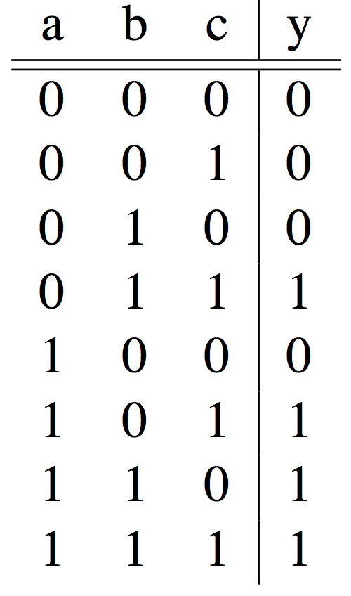
Truth Table Example #4:
3-input Majority Circuit
Y = A B C + A B C + A B C + A B C
This is called Sum of Products form;
Just another way to represent the TT
as a logical expression
Y = B C + A (B C + B C)
Y = B C + A (B + C)
More simplified forms
(fewer gates and wires)

Slide 38
Combinational Logic Symbols
Common combinational logic systems have standard symbols called logic gates
  Buffer, NOT
  AND, NAND
  OR, NOR
A
Z
A
Z
Easy to implement
with CMOS transistors
(the switches we have
available and use most)
B
A
Z
B

Slide 39
Agenda
Switching Networks, Transistors
Gates and Truth Tables for Circuits
Boolean Algebra
Logisim if there is time
And in Conclusion, …

Slide 40
Boolean Algebra
Use plus for OR
  “logical sum”
Use product for AND (a•b or implied via ab)
  “logical product”
“Hat” to mean complement (NOT)
Thus
ab + a + c
= a•b + a + c
= (a AND b) OR a OR (NOT c )

Slide 41
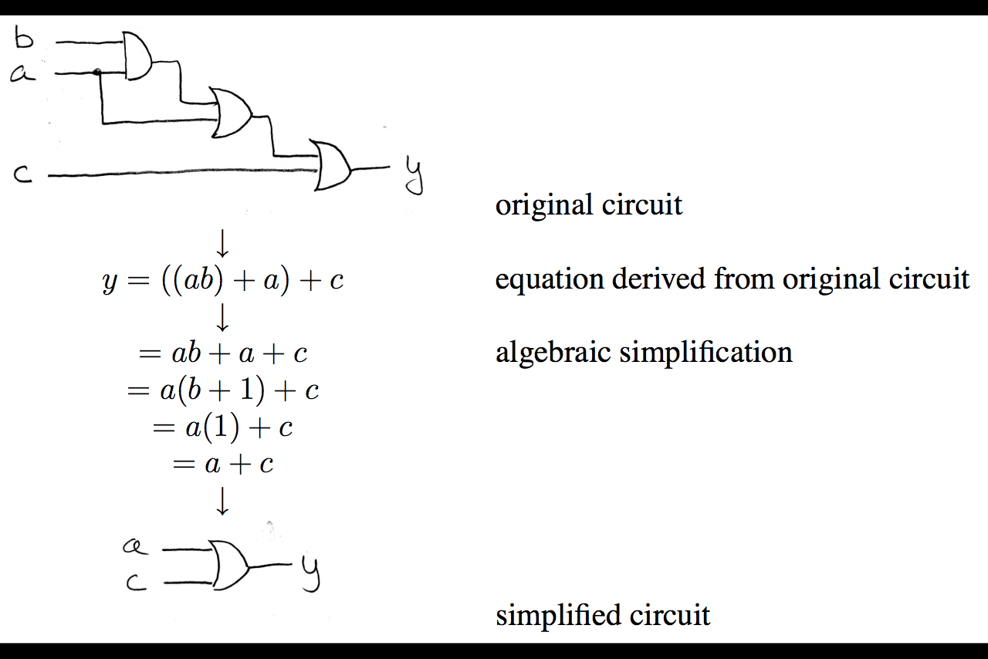
Boolean Algebra: Circuit & Algebraic Simplification

Slide 42
Laws of Boolean Algebra
X X = 0
X 0 = 0
X 1 = X
X X = X
X Y = Y X
(X Y) Z = Z (Y Z)
X (Y + Z) = X Y + X Z
X Y + X = X
X Y + X = X + Y
X Y = X + Y
X + X = 1
X + 1 = 1
X + 0 = X
X + X = X
X + Y = Y + X
(X + Y) + Z = Z + (Y + Z)
X + Y Z = (X + Y) (X + Z)
(X + Y) X = X
(X + Y) X = X Y
X + Y = X Y
Complementarity
Laws of 0’s and 1’s
Identities
Idempotent Laws
Commutativity
Associativity
Distribution
Uniting Theorem
United Theorem v. 2
DeMorgan’s Law

Slide 43
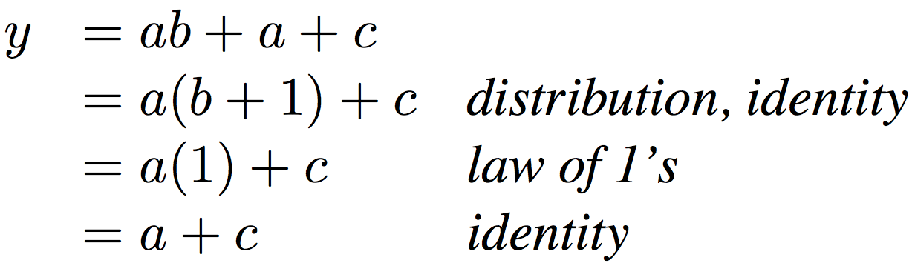
Boolean Algebraic Simplification Example
Notes:
Do on black board
First write truth table
Then minimize and check truth table
From distribution: a(b +1) + c
Froms laws of 0s and 1s: b+1 = 1
= a + c
Truth Table
a b c y
0 0 0 0
0 0 1 1
0 0 1 1

Slide 44
Boolean Algebraic Simplification Example
a b c y
0 0 0 0
0 0 1 1
0 1 0 0
0 1 1 1
1 0 0 1
1 0 1 1
1 1 0 1
1 1 1 1
Notes:
Do on black board
From distribution: a(b +1) + c
Froms laws of 0s and 1s: b+1 = 1
= a + c
Truth Table
a b c y
0 0 0 0
0 0 1 1
0 1 0 0
0 1 1 1
1 0 0 1
1 0 1 1
1 1 0 1
1 1 1 1

Slide 45
Design Hierarchy
system
datapath
control
code
registers
state
registers
combinational
logic
multiplexer
comparator
register
logic
switching
networks

Slide 46
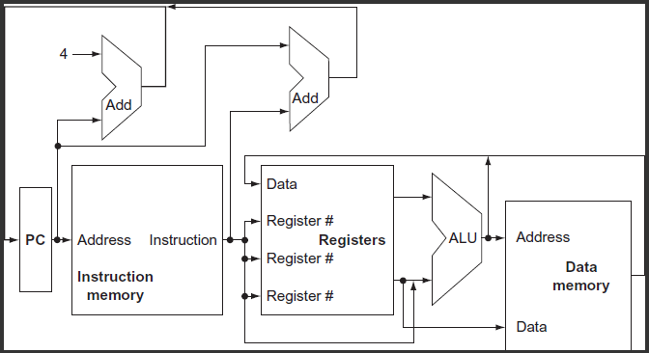
A Conceptual RISC-V Datapath

Slide 47
Administrivia
Midterm #1 Next Tuesday: September 26 IN CLASS!
  Review session Saturday, September 23: 2-4pm @VLSB 2050
    Approximately a fourth of the time dedicated to review
    Rest of time will be solving exam-level questions
  Midterm 1 room assignments will be posted on Piazza
  Students who have an exam conflict: head TA Steven will contact you by email with your testing arrangements.
  Homework 1 Part 2 due 11:59pm this Friday
  Guerrilla Session today 7-9pm in Cory 540AB
9/20/17
Fall 2017 - Lecture #9

Slide 48
Break!
9/20/17
Fall 2017 - Lecture #9

Slide 49
Agenda
Switching Networks, Transistors
Gates and Truth Tables for Circuits
Boolean Algebra
Logisim
State Machines
And in Conclusion, …

Slide 50
Logisim
Free schematic capture/logic simulation program in Java
  “A graphical tool for designing and simulating logic circuits”
  Search and download version 2.7.1, online tutorial
  ozark.hendrix.edu/~burch/logisim/
Drawing interface based on toolbar
  Color-coded wires aid in simulating and debugging a circuit
  Wiring tool draws horizontal and vertical wires, automatically connecting to components and to other wires.
Circuit layouts used as "subcircuits" of other circuits, allowing hierarchical circuit design
Included circuit components: inputs and outputs, gates, multiplexers, arithmetic circuits, flip-flops, RAM memory

Slide 51
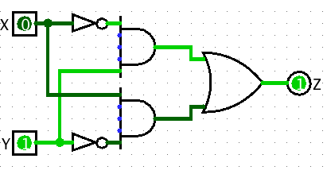
Logisim Wires
Blue wires: value at that point is "unknown”
Gray wires: not connected to anything
OK when in process of building a circuit
When finished => wires not be blue or gray
If connected, all wires should be green
  Bright green a 1
  Dark green a 0

Slide 52
Common Mistakes in Logisim
Connecting wires together
Using input for output
Connecting to edge without connecting to actual input
  Unexpected direction of input
Notes:
1. XOR Logic with Bug.circ
Works for 00, 10, 11, breaks for 01
(xor connected to input of gate – 2 wires with different values)
2. AndBug.circ
Works for 00, 10, 01, fails for 11
(its not unconnected inputs to And gate – change inputs to see)
(its using west facing input as an output)
3. counter without bug.circ
FSM not working as change input!
(facing wrong way)

Slide 53
Agenda
Switching Networks, Transistors
Gates and Truth Tables for Circuits
Boolean Algebra
Logisim
And in Conclusion, …

Slide 54
And in Conclusion, …
Linking and Loading
  Linker combines together separate modules, using the symbol and relocation tables to adjust addresses as necessary
  Loader moves an executable file from disk to memory in allow its execution
Multiple Hardware Representations
  Analog voltages quantized to represent logic 0 and logic 1
  Transistor switches form gates: AND, OR, NOT, NAND, NOR
  Truth table mapped to gates for combinational logic design
  Boolean algebra for gate minimization

